Slide 1


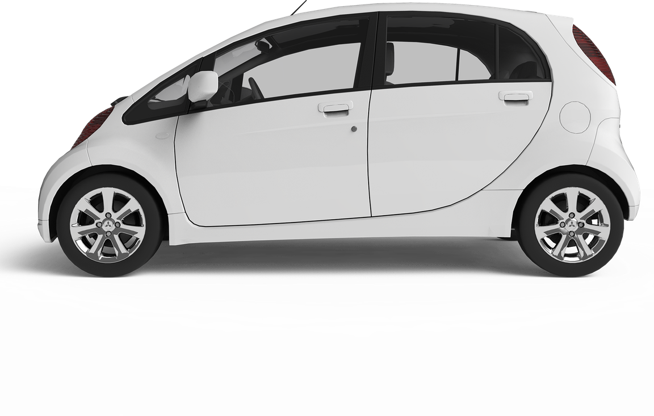

CHARGING TECHNIQUES OF
EV BATTERY
Larana Electric Car
Fast
Modern
Efficient

Slide 2
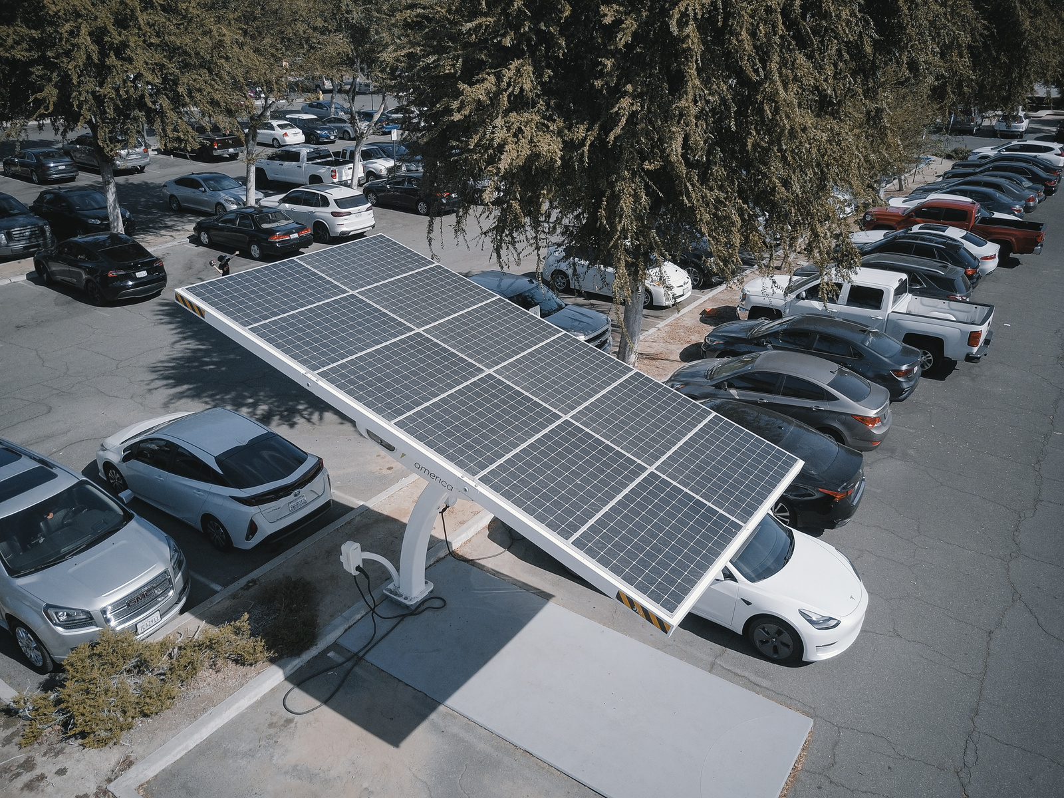


PROBLEM STATEMENT
To design and simulate a battery charging system using different charging methods to achieve fast ,efficient, and safe , charging of lithium ion battery
INTRODUCTION
  Battery charging significantly affects the performance, efficiency, and lifespan of rechargeable batteries used in applications like electric vehicles and portable devices.
  Various charging techniques such as CC, CV, CC–CV, and temperature-based methods are used to balance charging speed and safety.
  Each method has distinct characteristics in terms of voltage and current behavior, along with specific advantages and limitations.

Slide 3

MOTIVATION
  The increasing use of rechargeable batteries in EVs and electronics requires efficient and safe charging methods.
Understanding these effects is important to improve battery performance and reliability.
Different charging techniques affect temperature, speed, safety, and battery life in different ways.

Slide 4




Larana Electric Car
OBJECTIVES
To analyze how different charging techniques affect battery temperature and thermal behavior during charging.
Safety
Temperature
To evaluate the safety of each charging method in terms of overcharging, overheating, and risk of battery damage
Speed
Battery Life
To study the impact of charging methods on battery health and overall cycle life.
To compare the charging speed of different techniques by measuring the time taken to reach full charge

Slide 5
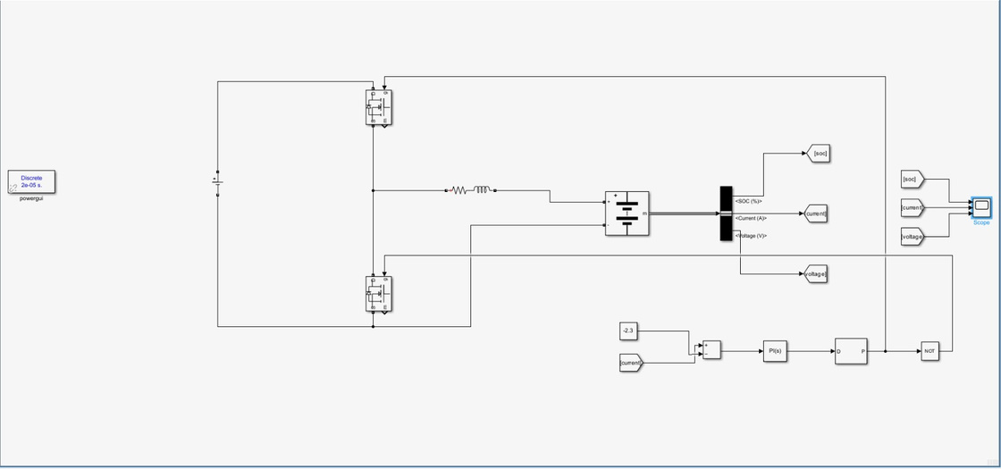
CC METHOD
Constant Current (CC) charging means supplying a steady current to the battery so it charges quickly, especially when it’s low on charge. As the battery fills up, its voltage rises.
  We observed that In constant current charging, the battery charges very rapidly without proper voltage control.
  This is causing the battery voltage to exceed its safe limit during charging.
  It leads to overcharging, overheating, and reduceing battery life.

Slide 6
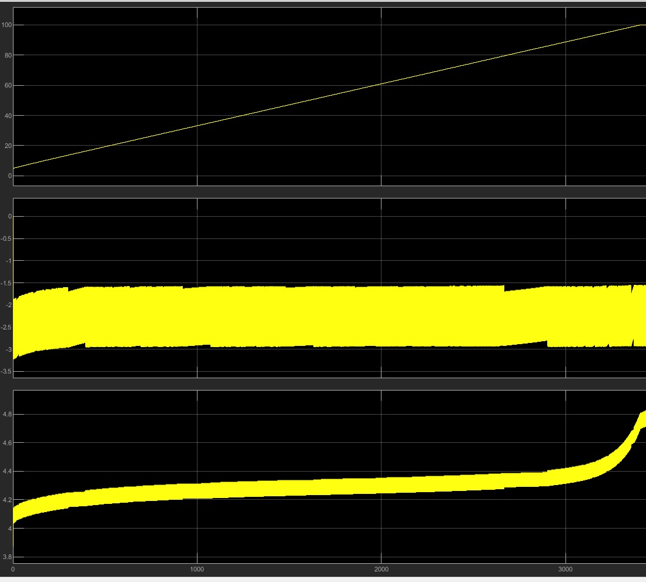
CC METHOD

Slide 7

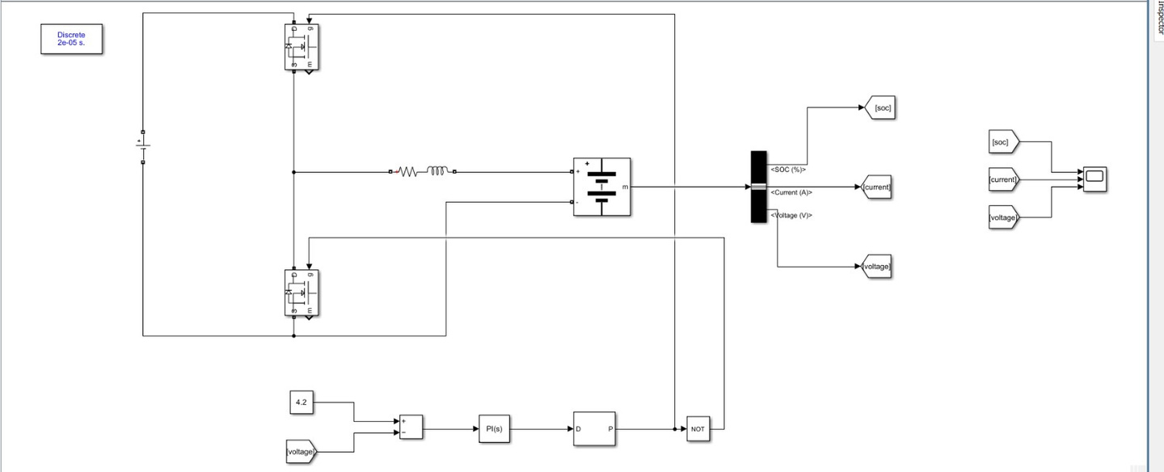
CV METHOD
Constant Voltage (CV) charging maintains a fixed voltage across the battery during charging. As the battery charges, the current gradually decreases while the voltage remains constant.
  We observe that, In constant voltage charging, the voltage is maintained fixed, causing the charging current to gradually decrease.
  This results in a very slow charging process, so it takes long time to reach 100% state of charge (SOC).

Slide 8
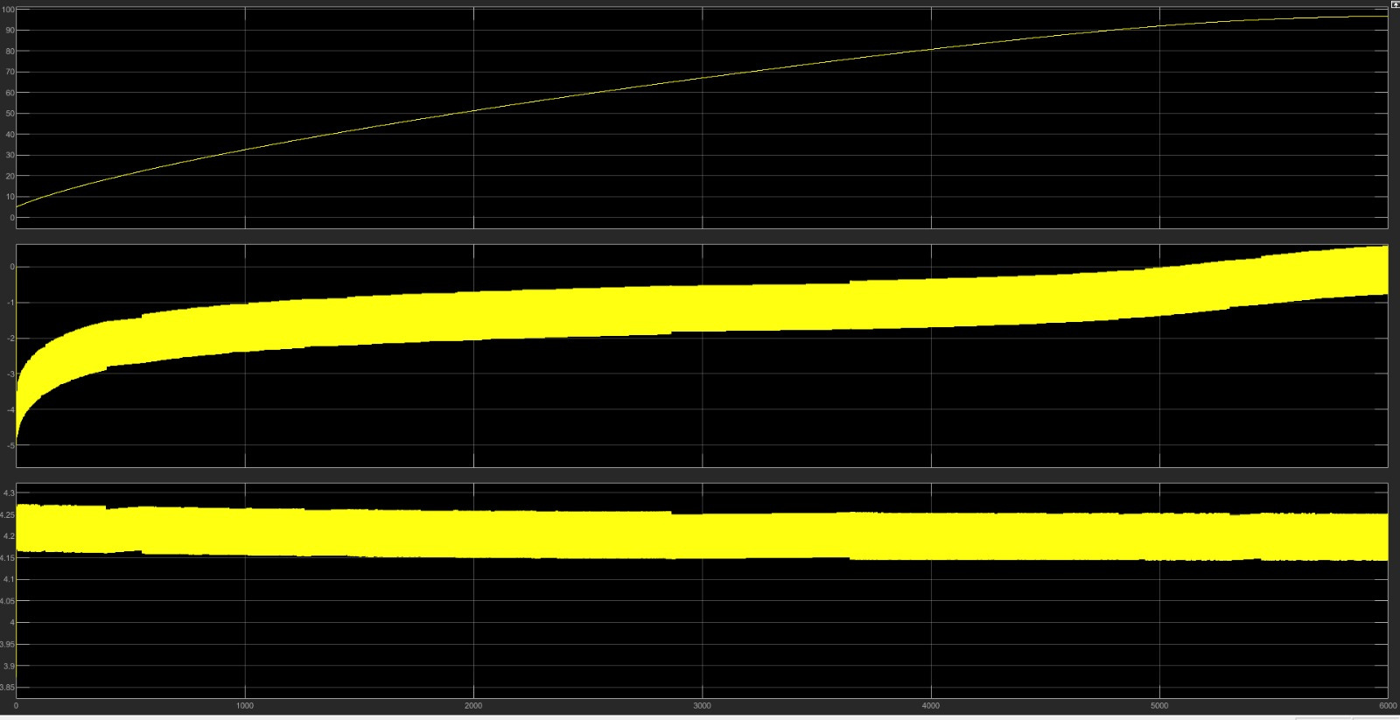
CV METHOD

Slide 9

CC-CV METHOD
CC–CV charging is a two-stage method that combines constant current and constant voltage charging. In the first stage, the battery is charged with a constant current, causing the voltage to gradually increase. Once the battery reaches its set maximum voltage, the method switches to constant voltage mode. In this second stage, the voltage is kept constant while the current slowly decreases. This approach ensures efficient charging in the beginning and safer, controlled charging as the battery reaches full capacity.
In this method we are able to control the overcharging and can reduce the charging time
But the charging control is more complex, requiring precise switching between constant current and constant voltage modes.

Slide 10
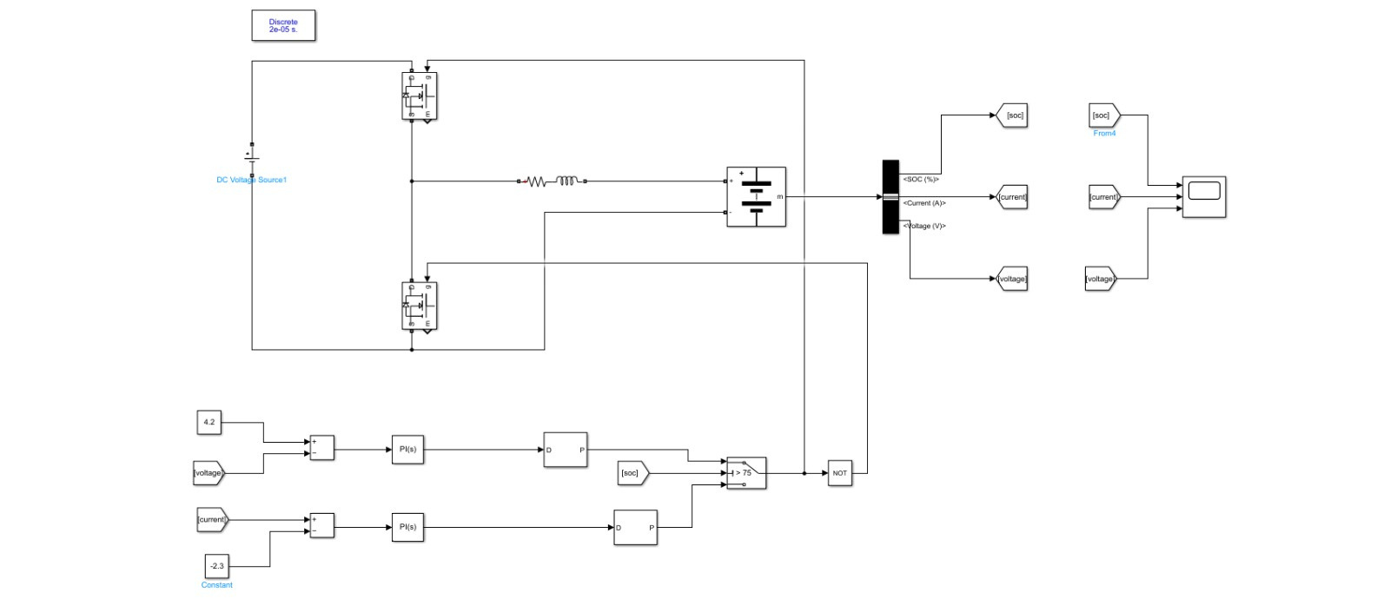
CC-CV METHOD

Slide 11

CC-CV METHOD

Slide 12
CT-CV METHOD
CT–CV charging combines temperature-based control with constant voltage charging. In the initial stage, the charging current is adjusted based on the battery’s temperature to prevent overheating. As the battery approaches its safe voltage limit, the method switches to constant voltage mode. In this stage, the voltage is held constant while the current gradually decreases
  In CT–CV charging, a thermal model is developed to monitor battery behavior during charging. This model helps in observing both internal temperature and surface temperature in real time.

Slide 13
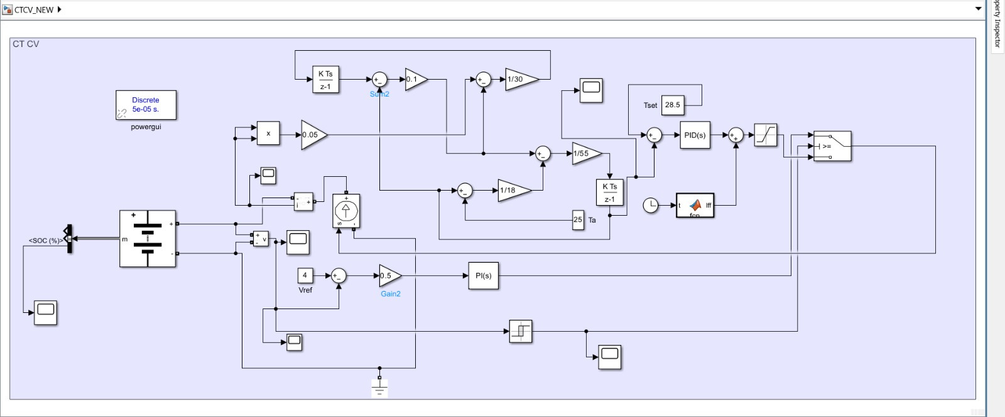
CT-CV METHOD

Slide 14
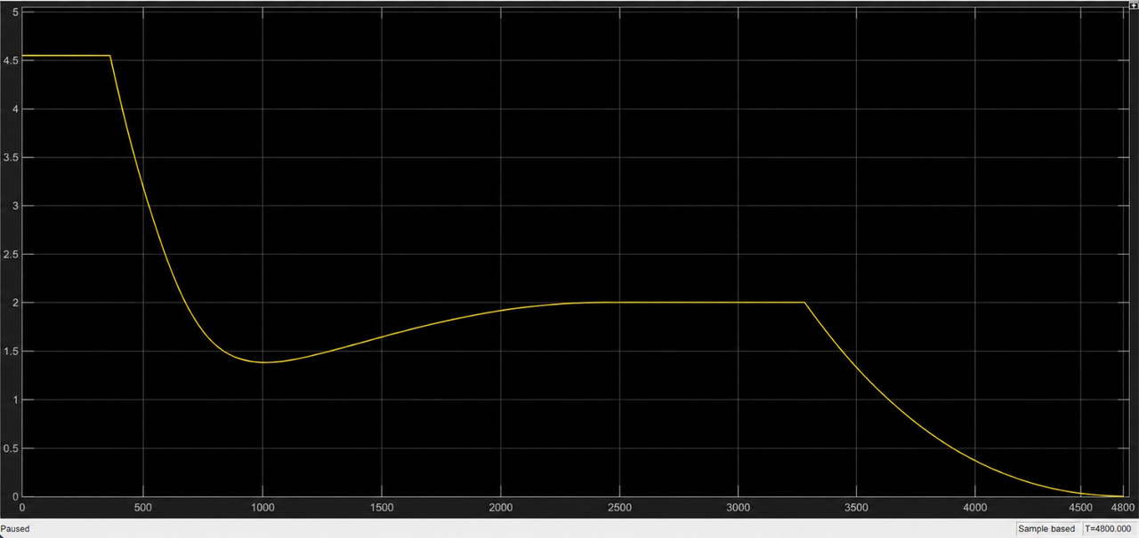
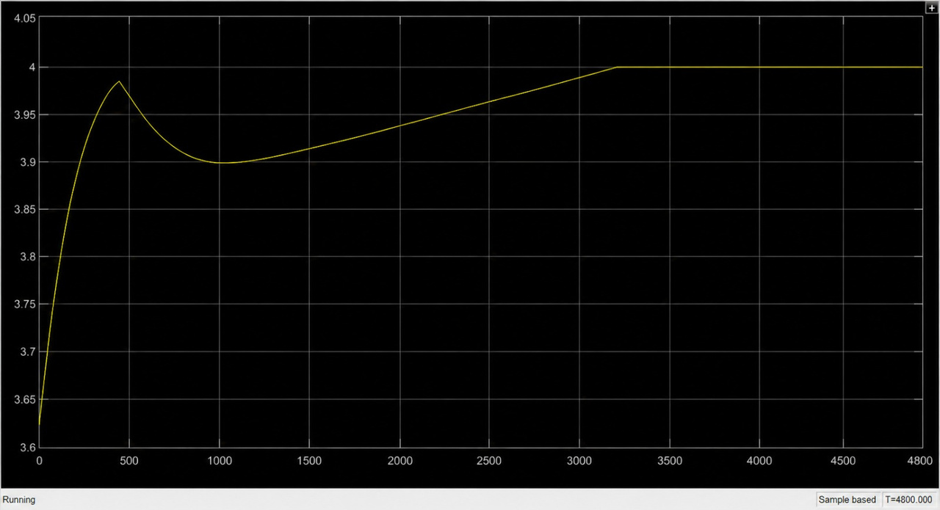
CURRENT Vs TIME
Vbattery Vs TIME

Slide 15
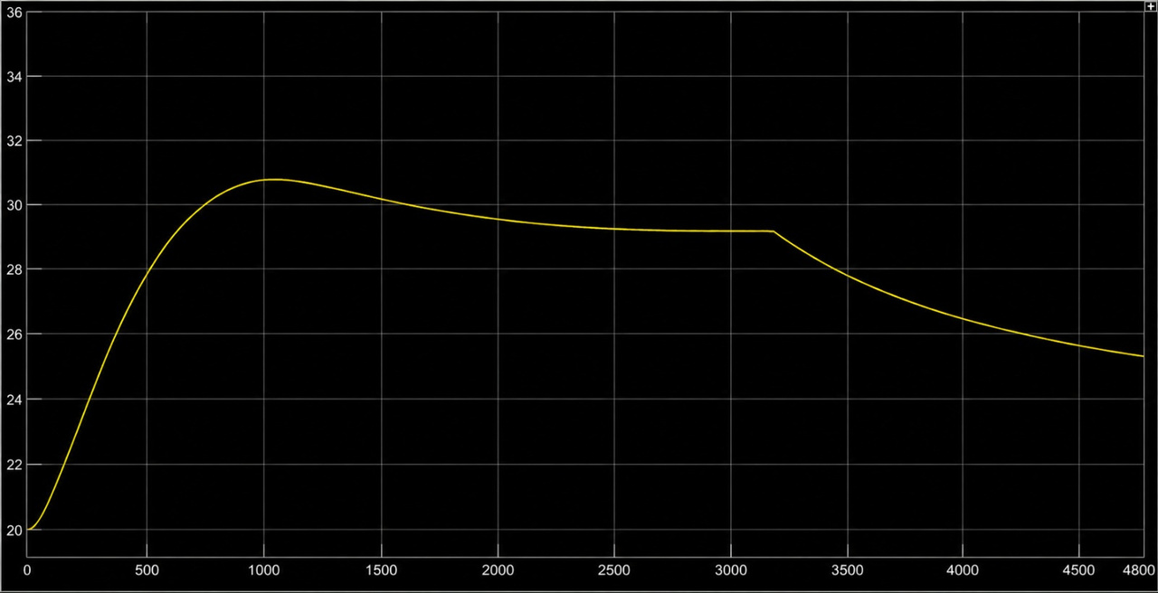
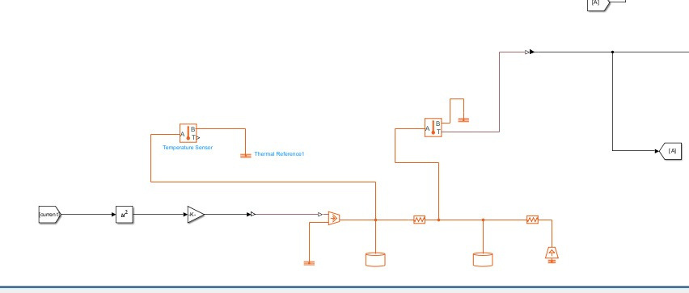
SURFACE TEMP Vs TIME
THERMAL MODEL USING REAL COMPONENTS

Slide 16
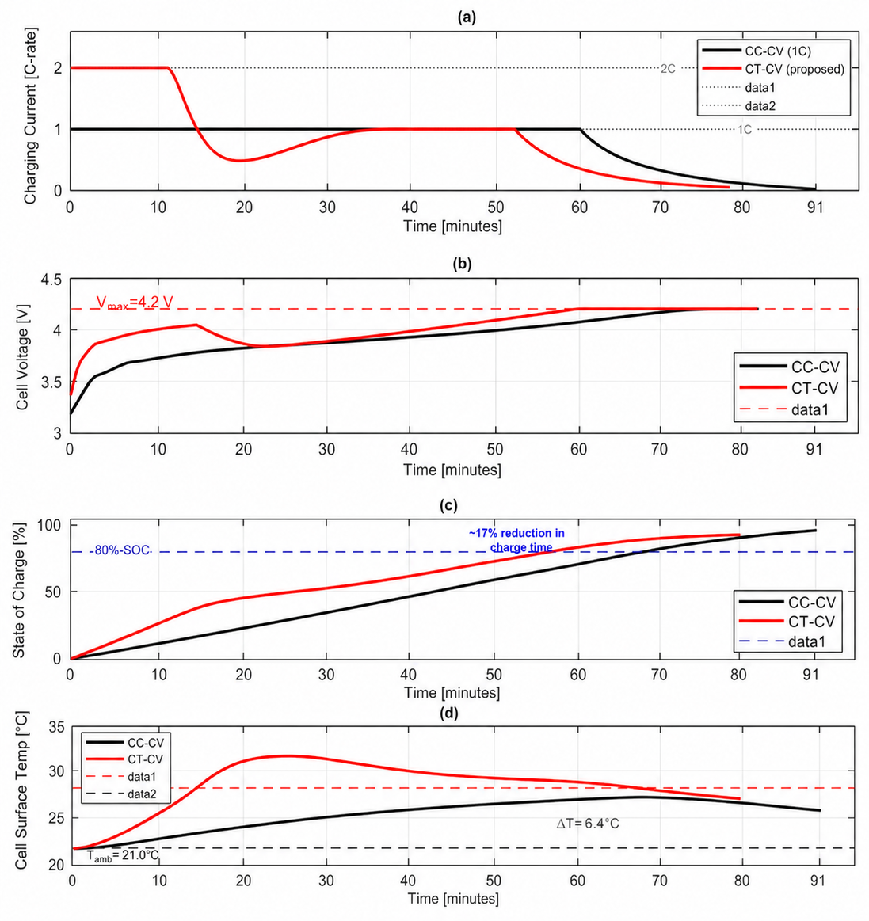
RESULTS
METHOD
CHARGING TIME
TEMPERATURE RISE
  CC
61 min
  CV
104 min
  CC-CV
91 min
  ΔT=6.5°C
  CT-CV
80 min
  ΔT=6.5°C

Slide 17
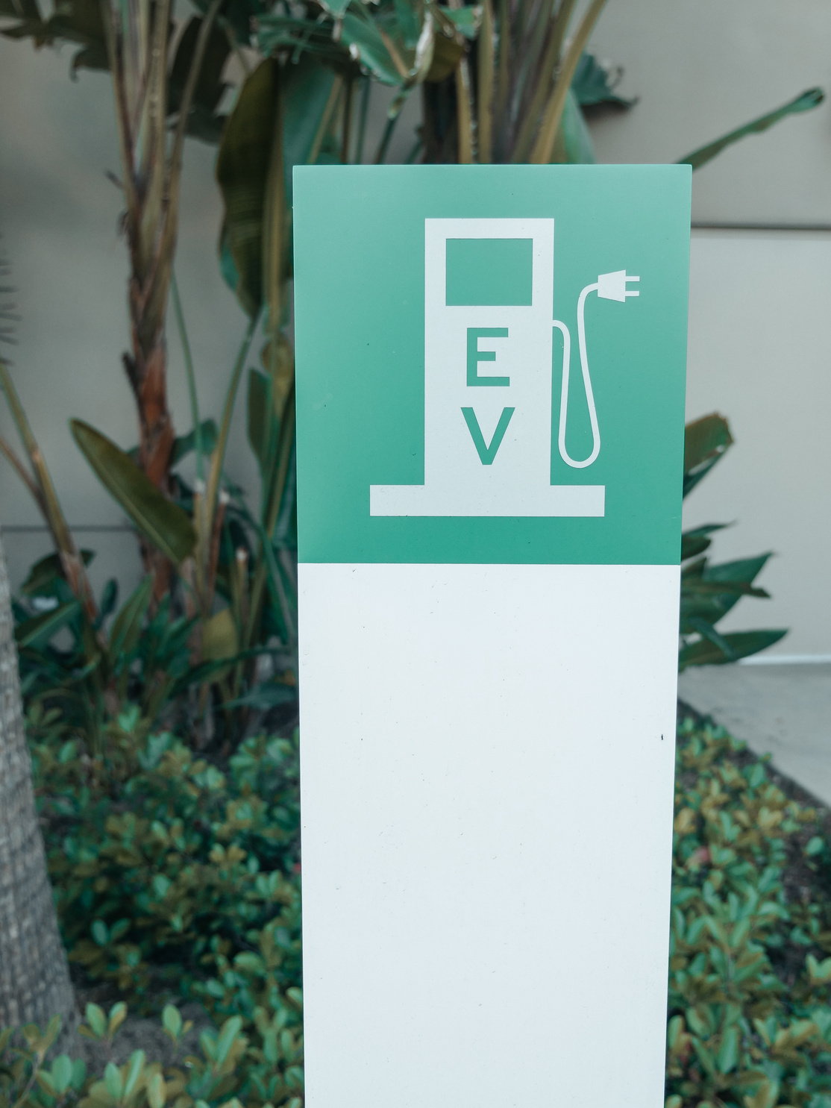
CONCLUSION
  The proposed charging profile reduces the overall charging time compared to the conventional CC–CV method.
  It effectively limits the temperature rise by incorporating thermal control during charging.
  Thus, the CT-CV method ensures faster, safer, and more efficient battery charging performance.
REFERENCE:
IEEE PAPERS:
A Closed-Loop Constant-Temperature Constant-Voltage Charging Technique to Reduce Charge Time of Lithium-Ion Batteries
Performance Analysis of the Lithium-Ion Batteries using CT-CV Charging Technique

Slide 18

Thank You!
project by
Larana Electric Car
ANKIT VERMA-240002008
MIDATANA DHILEEP-240002038
PANKAJ KUMAR-240002048
SIDDHARTHA PORIKA-240002071
SATHVIK RATHOD-240002067
Fast
Modern
Efficient

